Slide 1
C++ Inheritance
Ms. Zahra Ali

Slide 2
What is Inheritance?
In C++, inheritance is a process in which one object acquires all the properties and behaviors of its parent object automatically. In such way, you can reuse, extend or modify the attributes and behaviors which are defined in other class.
In C++, the class which inherits the members of another class is called derived class and the class whose members are inherited is called base class. The derived class is the specialized class for the base class.

Slide 3
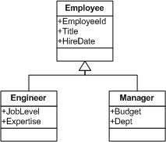
Inheritance in C++

Slide 4
Advantage of C++ Inheritance
Code reusability:
Now you can reuse the members of your parent class. So, there is no need to define the member again. So less code is required in the class.

Slide 5
Types Of Inheritance
C++ supports five types of inheritance:
Single inheritance
Multiple inheritance
Hierarchical inheritance
Multilevel inheritance
Hybrid inheritance

Slide 6
Parent class
Derive Class
Derive Class

Slide 7
Derived Classes
class derived_class_name :: visibility-mode base_class_name
{
// body of the derived class.
}

Slide 8
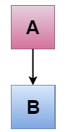
C++ Single Inheritance
Single inheritance is defined as the inheritance in which a derived class is inherited from the only one base class.

Slide 9
C++ Single Level Inheritance Example: Inheriting Fields
#include <iostream>
using namespace std;
class Account {
public:
float salary = 60000;
};
class Programmer: public Account {
public:
float bonus = 5000;
};
int main(void) {
Programmer p1;
cout<<"Salary: "<<p1.salary<<endl;
cout<<"Bonus: "<<p1.bonus<<endl;
return 0;
}

Slide 10
C++ Single Level Inheritance Example: Inheriting Methods
#include <iostream>
using namespace std;
class Animal {
public:
void eat() {
cout<<"Eating..."<<endl;
}
};
class Dog: public Animal
{
public:
void bark(){
cout<<"Barking...";
}
};
int main(void) {
Dog d1;
d1.eat();
d1.bark();
return 0;
}

Slide 11
How to make a Private Member Inheritable
The private member is not inheritable. If we modify the visibility mode by making it public, but this takes away the advantage of data hiding.
C++ introduces a third visibility modifier, i.e., protected. The member which is declared as protected will be accessible to all the member functions within the class as well as the class immediately derived from it.

Slide 12
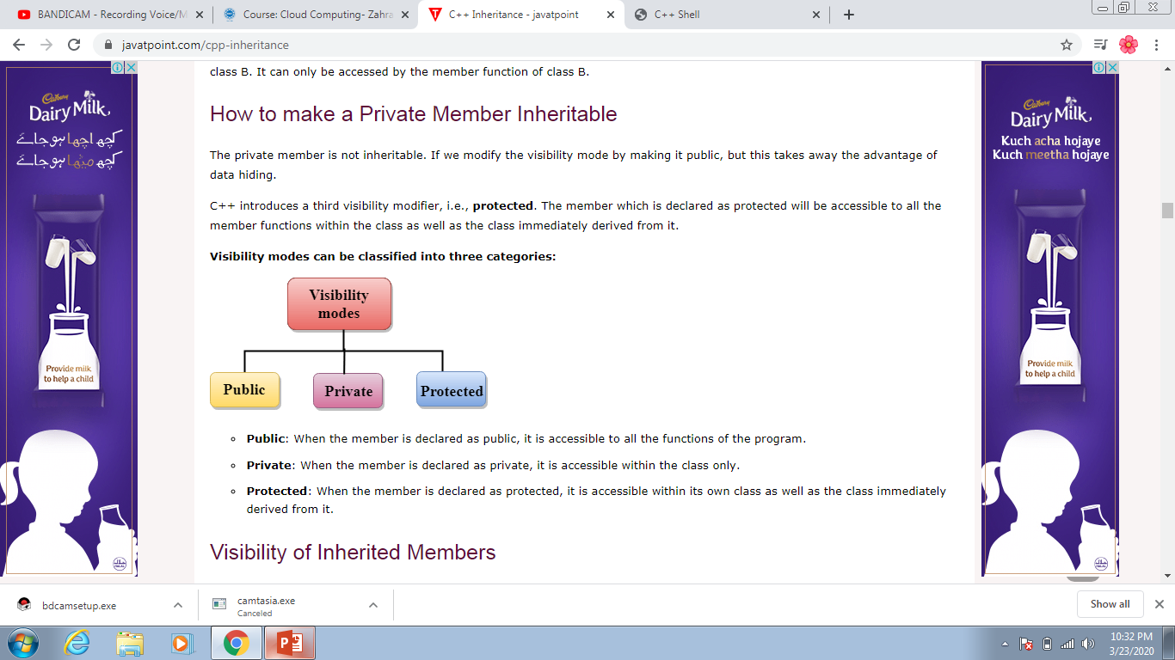
Visibility modes can be classified into three categories:

Slide 13
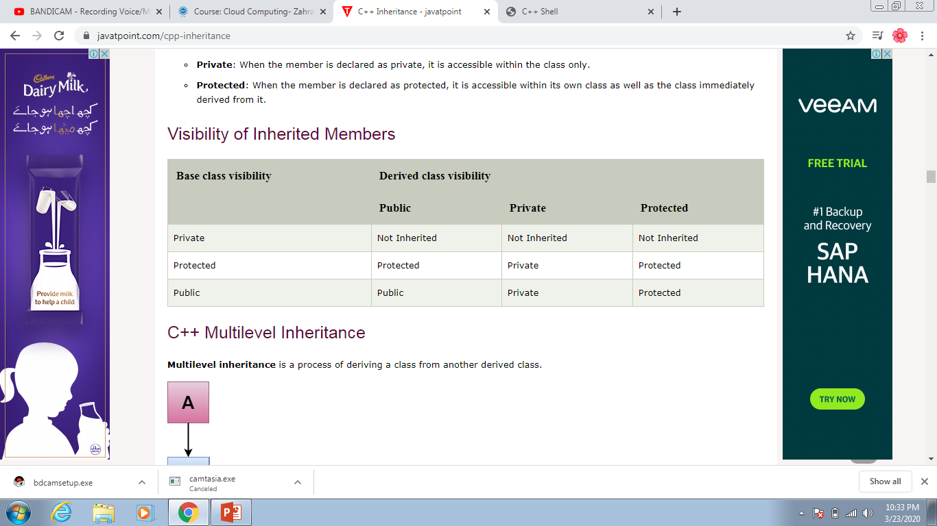
Visibility of Inherited Members

Slide 14
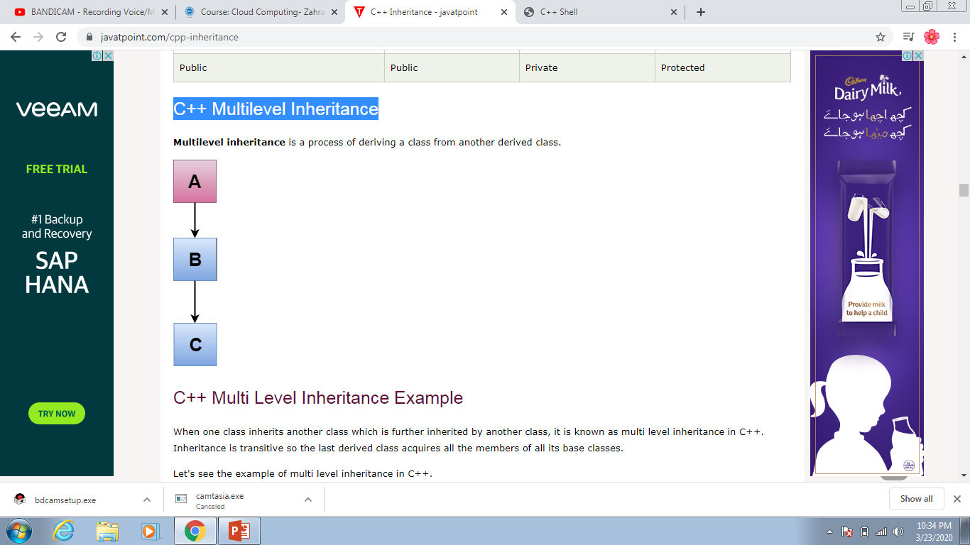
C++ Multilevel Inheritance

Slide 15
C++ Multi Level Inheritance Example
#include <iostream>
using namespace std;
class Animal {
public:
void eat() {
cout<<"Eating..."<<endl;
}
};
class Dog: public Animal
{
public:
void bark(){
cout<<"Barking..."<<endl;
}
};
class BabyDog: public Dog
{
public:
void weep() {
cout<<"Weeping...";
}
};

Slide 16
Example Part 2
int main(void) {
BabyDog d1;
d1.eat();
d1.bark();
d1.weep();
return 0;
}

Slide 17
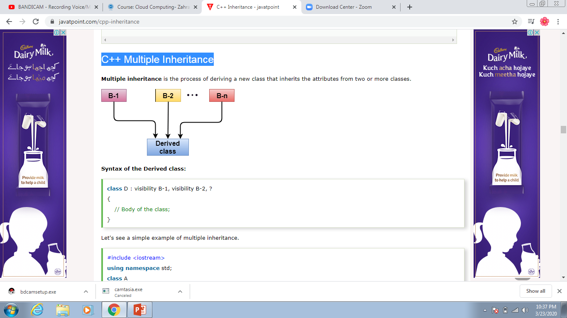
C++ Multiple Inheritance

Slide 18
C++ Multiple Inheritance
class D : visibility B-1, visibility B-2, ?
{
// Body of the class;
}

Slide 19
Example
#include <iostream>
using namespace std;
class A
{
protected:
int a;
public:
void get_a(int n)
{
a = n;
}
};

Slide 20
class B
{
protected:
int b;
public:
void get_b(int n)
{
b = n;
}
};

Slide 21
class C : public A,public B
{
public:
void display()
{
std::cout << "The value of a is : " <<a<< std::endl;
std::cout << "The value of b is : " <<b<< std::endl;
cout<<"Addition of a and b is : "<<a+b;
}
};

Slide 22
int main()
{
C c;
c.get_a(10);
c.get_b(20);
c.display();
return 0;
}

Slide 23
class A
{
public:
void display()
{
cout<<?Class A?;
}
} ;
class B
{
public:
void display()
{
cout<<?Class B?;
}
} ;

Slide 24
int main()
{
B b;
b.display(); // Calling the display() function of B class.
b.B :: display(); // Calling the display() function defined in B class.
}

Slide 25
Assignment Task
Take a class virus (id, name , type), take a child class corona_virus that could reuse the properties of its parent class virus. In main () display all the values.

